Slide 1

FRA Project(Milestone-1)
By,
Balasubramaniyam.R

Slide 2
Contents of the presentation
Problem Statement
Outlier Treatment
Missing Value Treatment
Transform Target variable into 0 and 1
Univariate & Bivariate analysis with proper interpretation.
Train Test Split
Building a Logistic Regression Model (using statsmodel library) on most important variables on Train Dataset and choose the optimum cutoff. Also showcased the model building approach
Validation of the Model on Test Dataset and the performance matrices. Interpretation from the model

Slide 3
Problem Statement: Businesses or companies can fall prey to default if they are not able to keep up their debt obligations. Defaults will lead to a lower credit rating for the company which in turn reduces its chances of getting credit in the future and may have to pay higher interests on existing debts as well as any new obligations. From an investor's point of view, he would want to invest in a company if it is capable of handling its financial obligations, can grow quickly, and is able to manage the growth scale. A balance sheet is a financial statement of a company that provides a snapshot of what a company owns, owes, and the amount invested by the shareholders. Thus, it is an important tool that helps evaluate the performance of a business. Data that is available includes information from the financial statement of the companies for the previous year (2015). Also, information about the Networth of the company in the following year (2016) is provided which can be used to drive the labeled field. Explanation of data fields available in Data Dictionary, 'Credit Default Data Dictionary.xlsx'

Slide 4
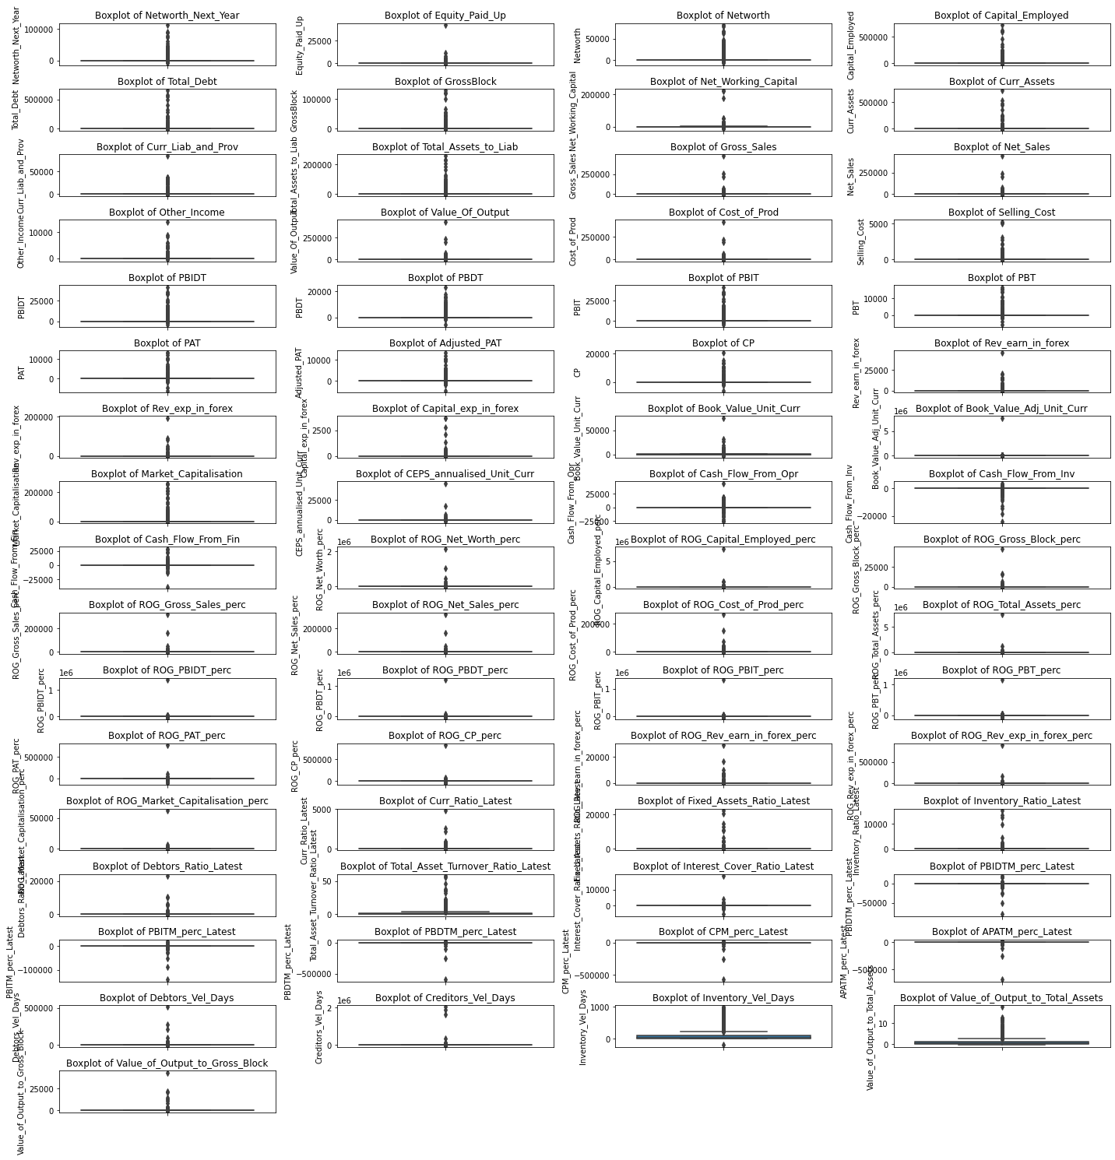
Outlier Treatment
There are 65 features in our dataset apart from Company name and Company Code.
All these features are having outliers present in them.

Slide 5
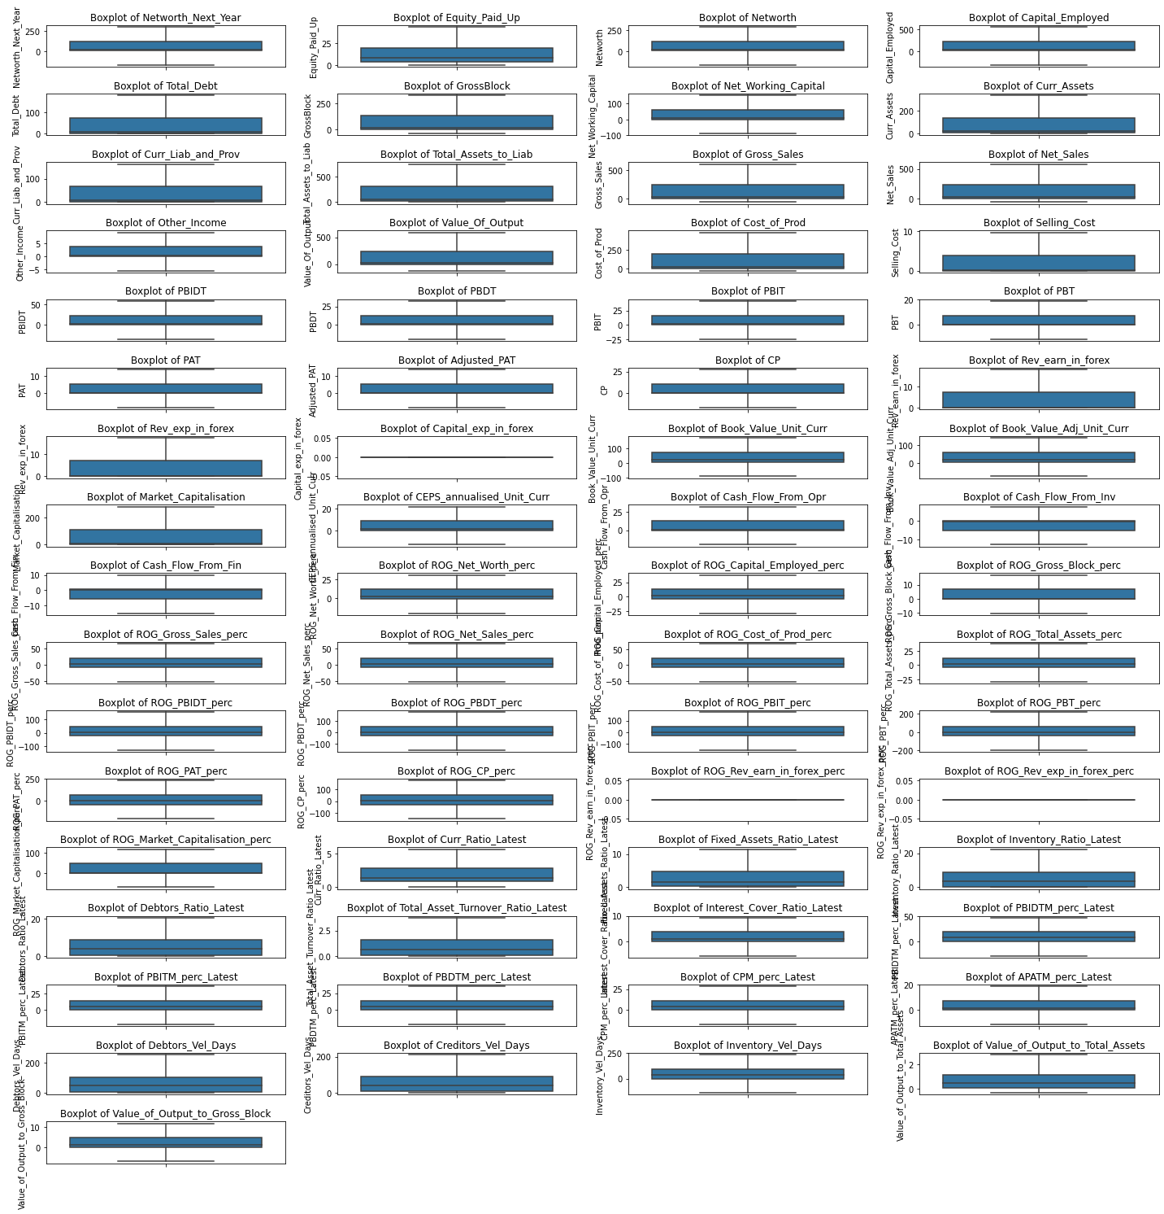
The outliers of our dataset are treated with upper limit values for extreme values more than upper limit, lower limit values used for extreme values less than lower limit.

Slide 6

Missing Value Treatment
The data set has missing values in
Book_Value_Adj_Unit_Curr
Current_Ratio_Latest
Fixed_Assets_Ratio_Latest
Inventory_Ratio_Latest
Debtors_Ratio_Latest
Total_Asset_Turnover_Ratio_Latest
Interest_Cover_Ratio_Latest
PBIDTM_perc_Latest
PBITM_perc_Latest
PBDTM_perc_Latest
CPM_perc_Latest
APATM_perc_Latest
Inventory_Velocity_Days.

Slide 7

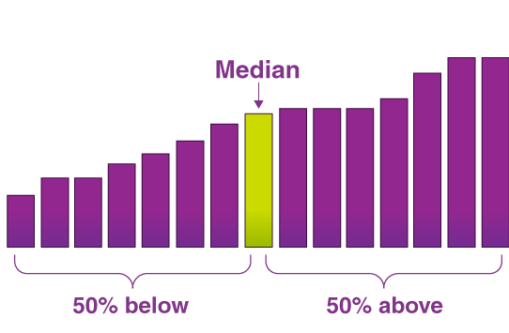
The missing values in the features are replaced with the median values of the respective features.

Slide 8
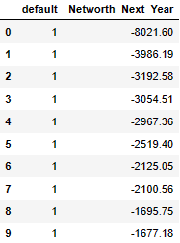
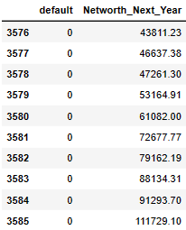
Transform Target variable into 0 and 1
A new default feature is created by coding the negative and positive values of the net worth next year feature .
The default variable is coded as 1 when net worth next year is negative & 0 when net worth next year is positive.

Slide 9
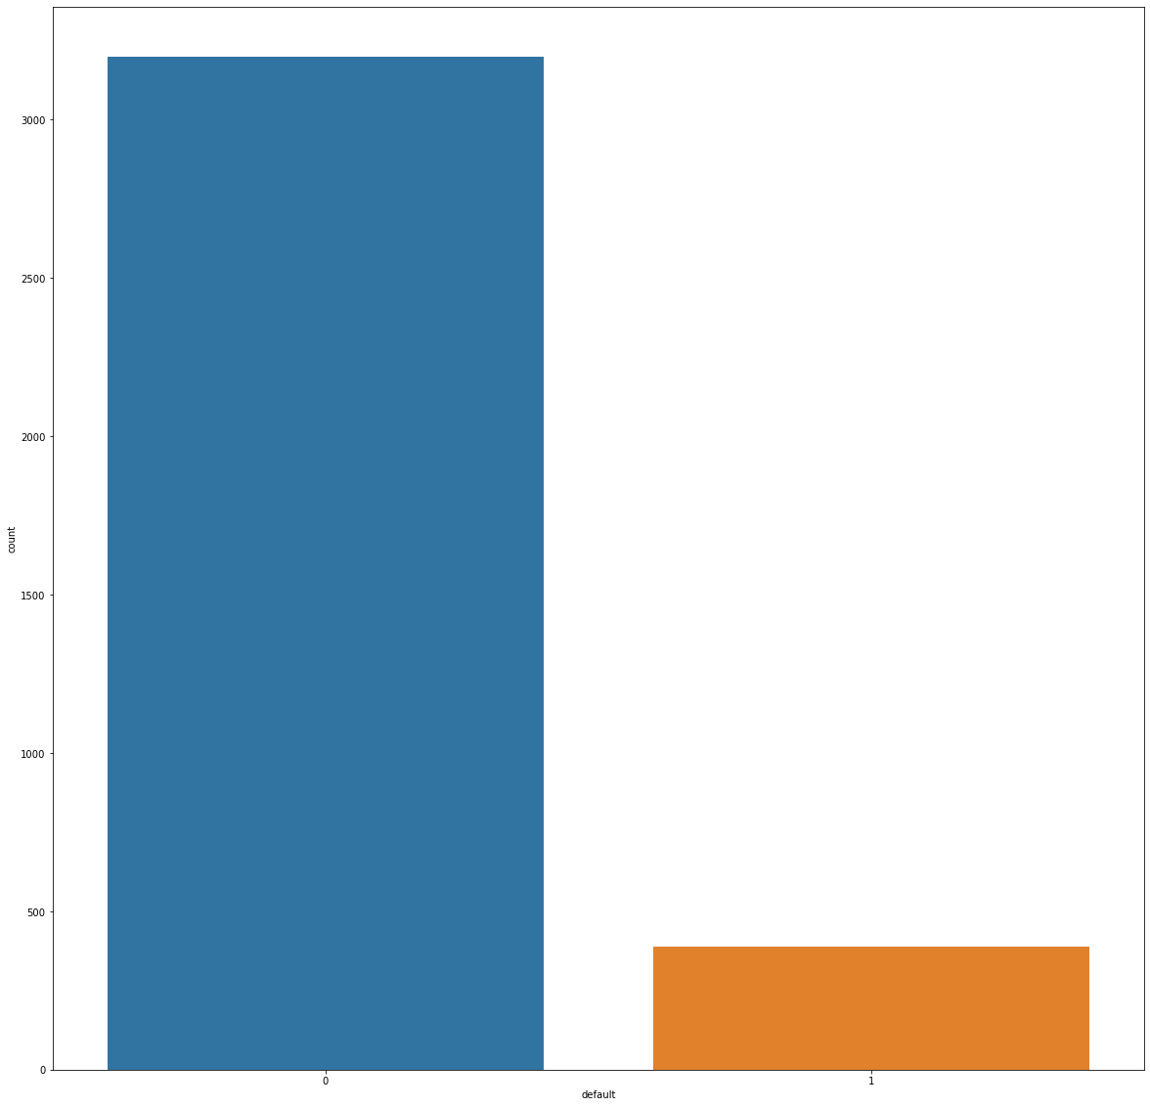
Default variable Plot
Univariate& Bivariate analysis
There is a total of 3586 companies in our dataset and in that 3198 are non-defaulters and 388 are defaulters.

Slide 10
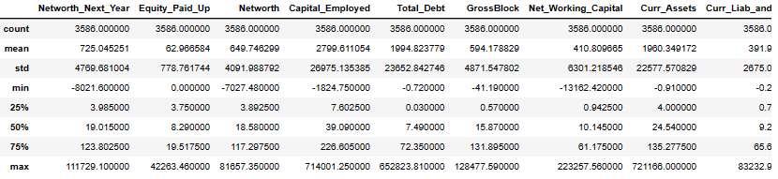
Data summary
The dataset contains 63 variables of float64 datatype, 3 variables of int64 datatype, and 1 variables of object datatype.
The number of rows (observations) is 3586
The number of columns (variables) is 67
There are no duplicate rows in our dataset.

Slide 11
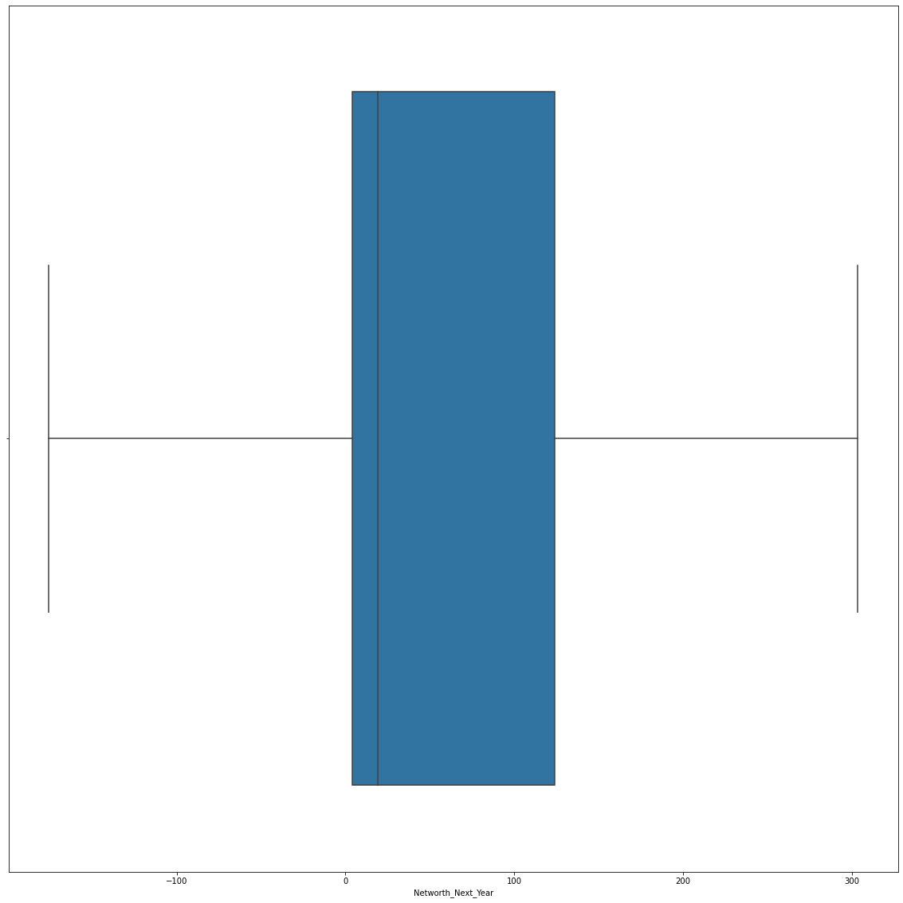
From the plot 11% of the companies are expected to have more liabilities and are having a possibility to default. More number of companies lies between 50% to 75% of the net worth in 2016.
Net worth next year box Plot

Slide 12
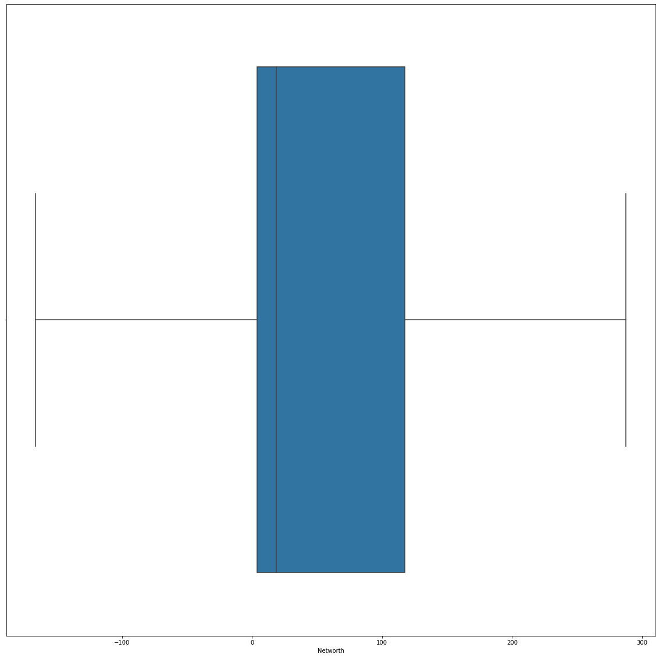
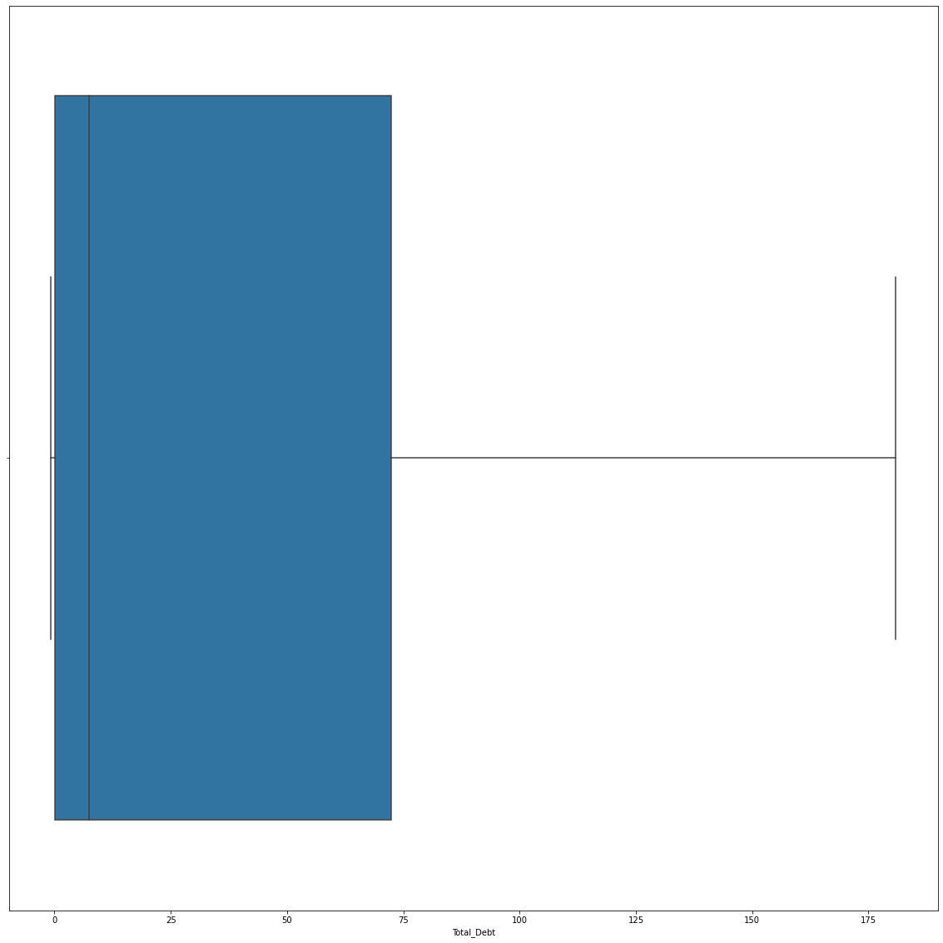
Net worth box Plot
Total debt box Plot
75% of the companies are valued at more than
Rs.1,20,000 as on 2015.
75% of the companies have borrowed more than Rs.70,000

Slide 13
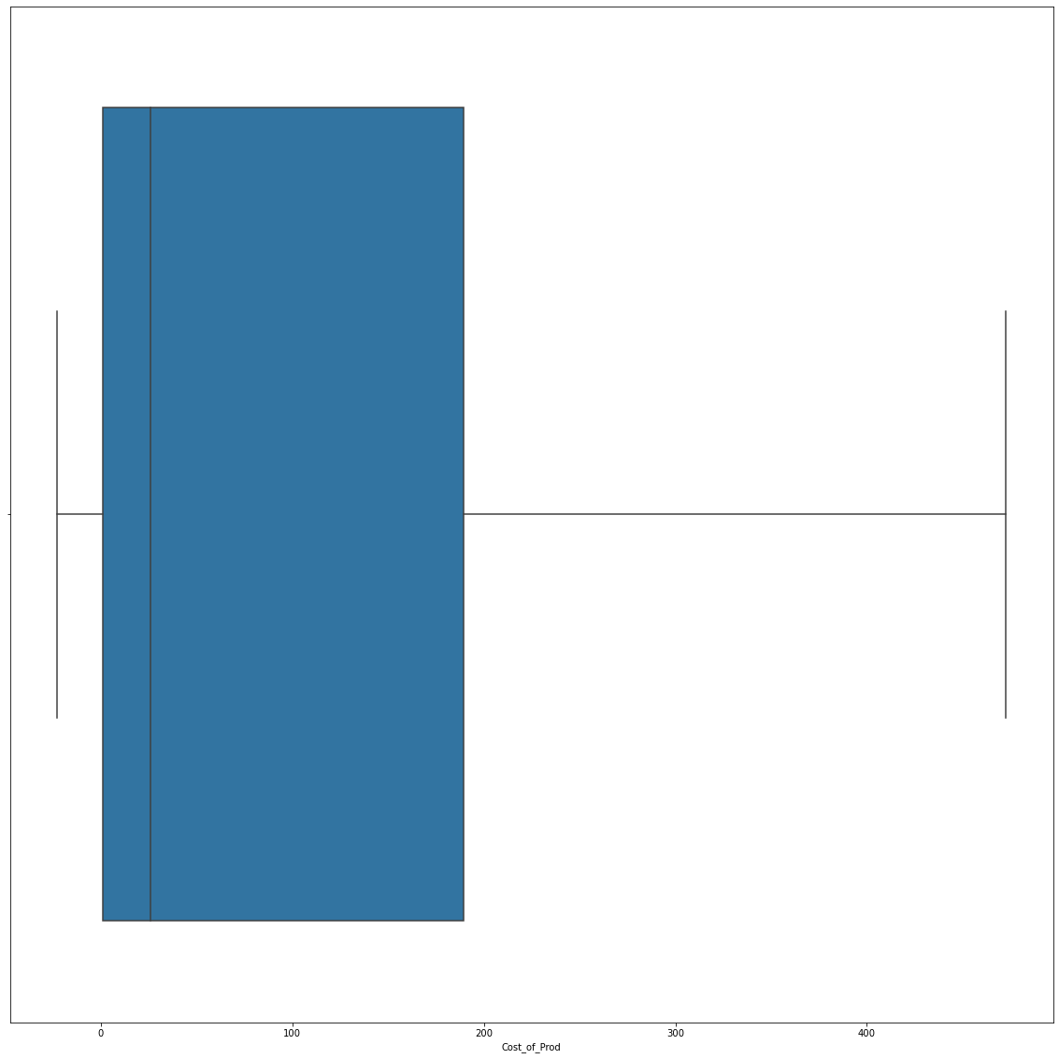
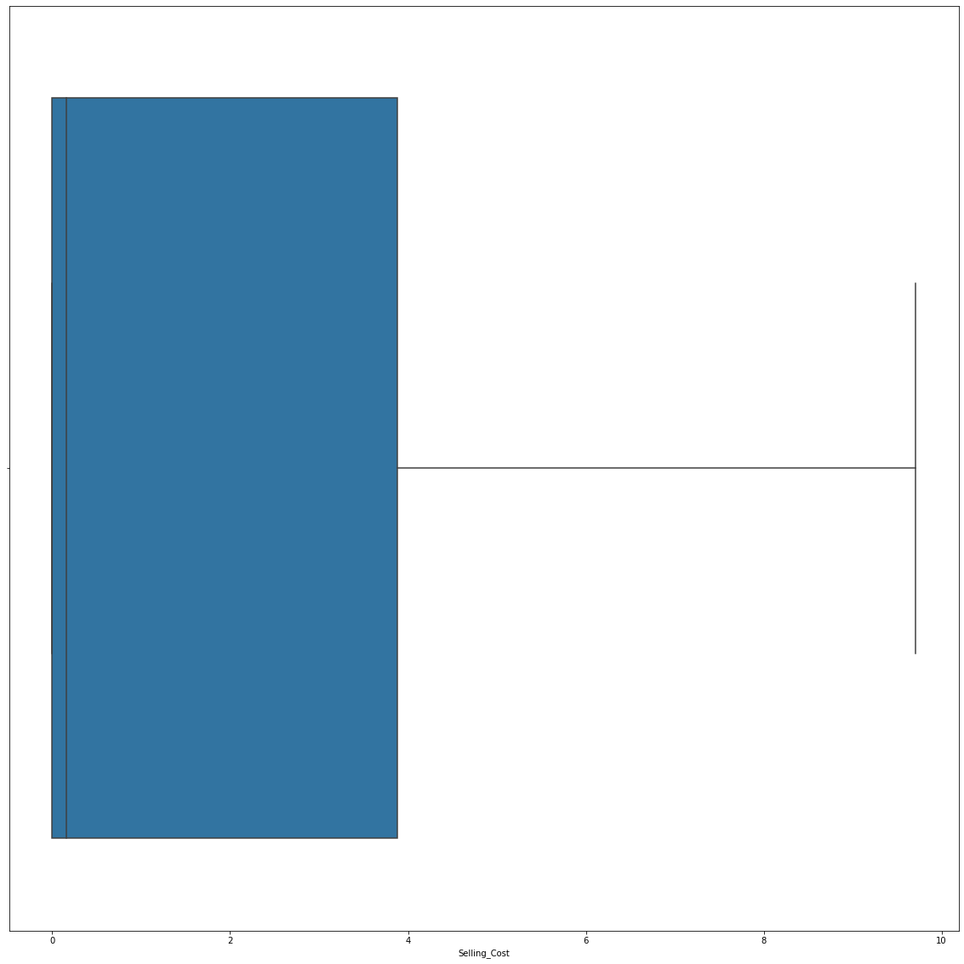
Cost_of_Prod box Plot
Selling_Costbox Plot
75% of the companies products are costing
Less than Rs.20,000
75% of the companies products are having a selling cost less than Rs.400

Slide 14
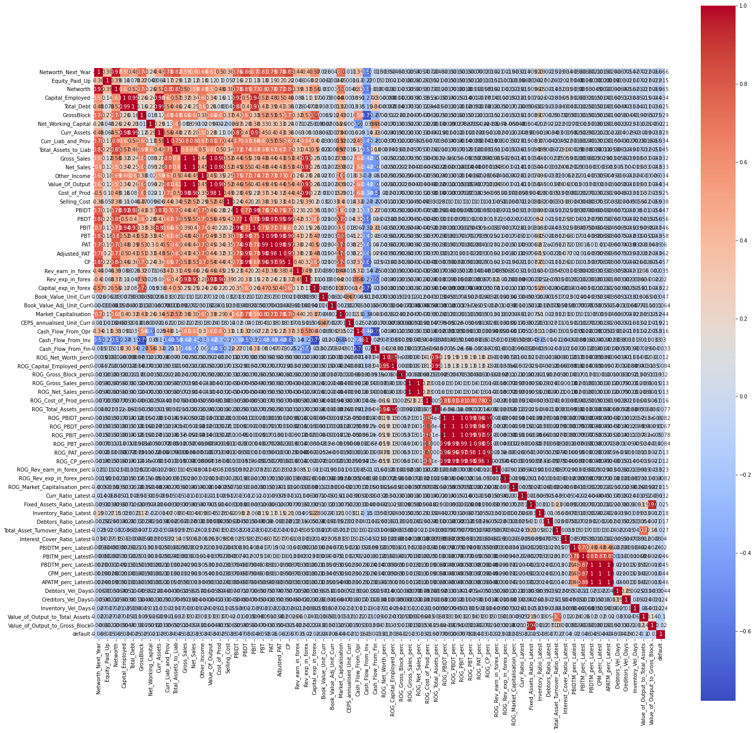
Heat map
The dataset features are highly corelated to each other.
A change in anyone of the independent variable could have an impact on the other independent variable.
Dimension reduction techniques are required for building an optimized model.

Slide 15
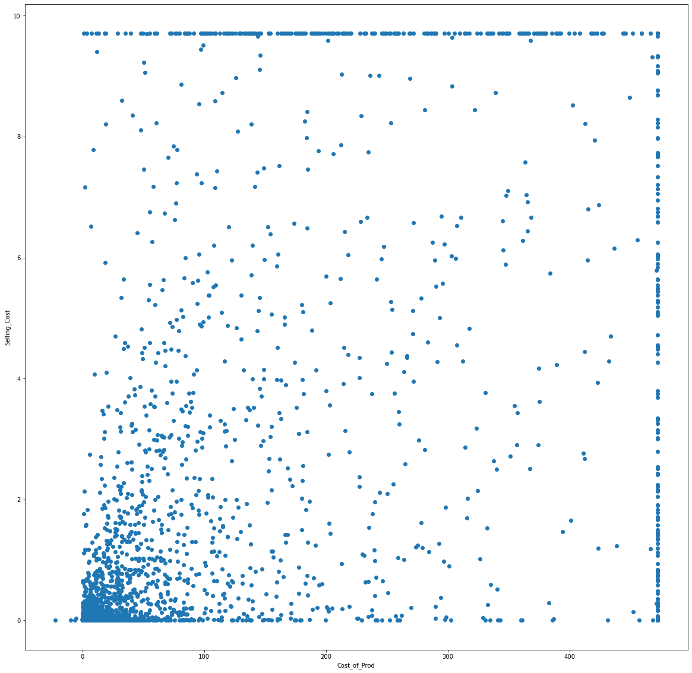
Cost of prod vs selling cost
No significant relationships are found.

Slide 16
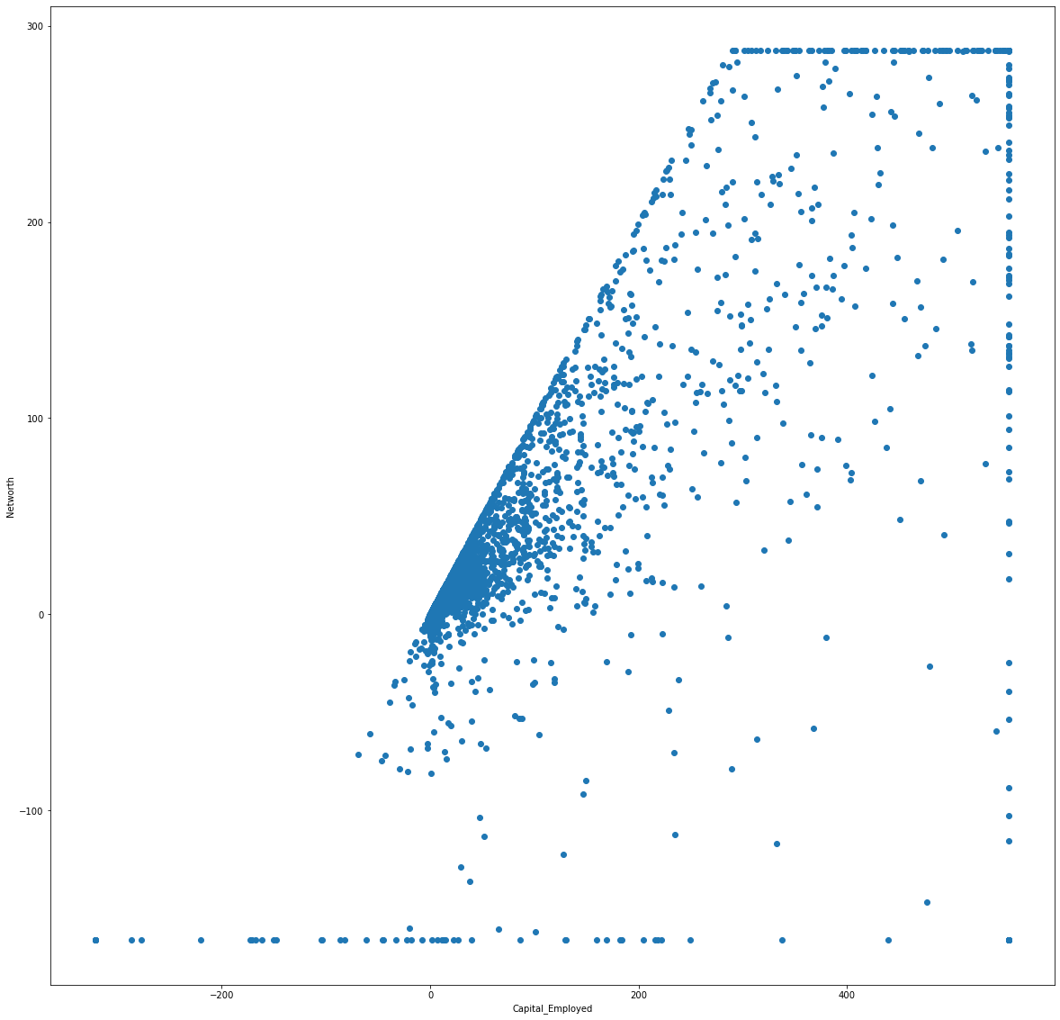
Capital_Employed vs Networth
As the Total amount of capital used for the acquisition of profits by a company increases the current Value of company also increases.

Slide 17
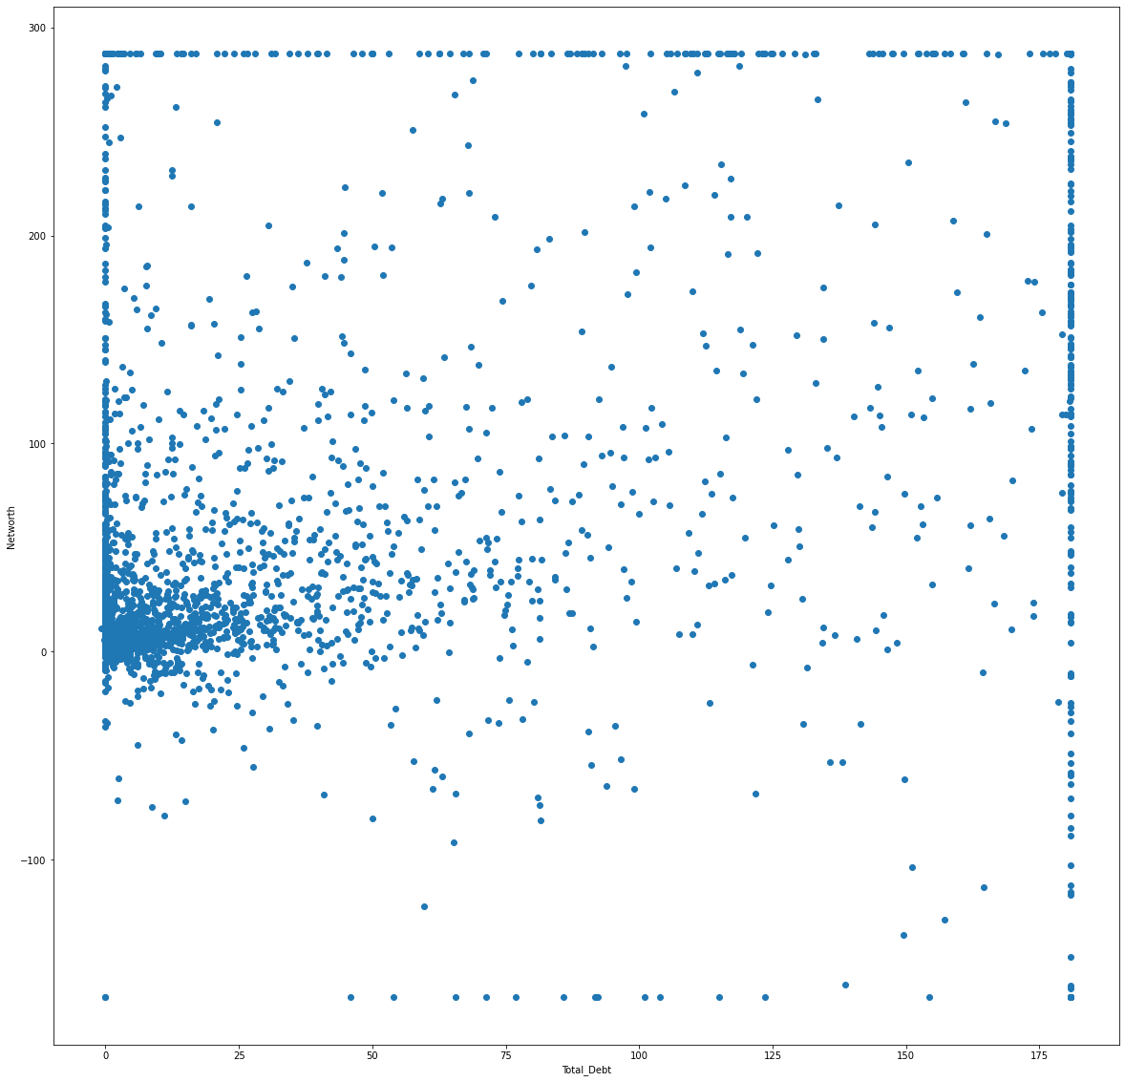
Total_Debt vs Networth
Most companies with higher net worth are having lower debt and is less than Rs.75,000.

Slide 18
Train Test Split
The dataset is split into 67% training data and 33% for testing data.
Independent variables Training data shape (2402, 65), Testing data shape (1184, 65).
Dependent variables Training data shape(2402,) Testing data shape (1184,)
Model
The Logistic regression model is build after performing PCA to reduce the dimensionality in the dataset.
optimal_threshold=0.15919105078869886

Slide 19
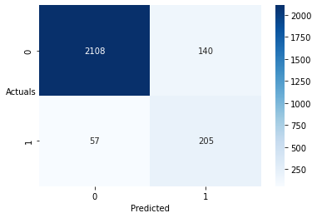
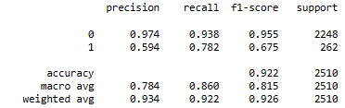
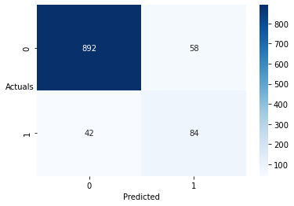
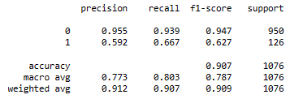
Training data performance
Test data performance

Slide 20
model has an accuracy of 92% and 90% in training and test datasets. model has an precision of 59% and 59% in training and test datasets. model has an recall of 78% and 66% in training and test datasets.
As the model is having good accuracy and recall values we can say the performance is satisfactory in testing data.

Slide 21
Thank you!
Model is built by performing missing value treatment, outlier treatment, PCA treatment.

